Slide 1
Media Literacy in the National Curriculum - Bulgaria
2019-1-SI01-KA229-060523
Fake News among Teenagers –
Towards a more responsible media literacy

Slide 2
School Subjects
Health Education:
What influence does
media consumption have on what
we eat? How does it affect our
decisions about smoking, drinking,
and drug use?
Music:
How do the commercial pressures of the music
industry affect the creation of music?
How are things like gender, relationships, or alcohol
use depicted in music videos, and how do youth
interpret these messages?
How are musicians portrayed in media,
and how does that influence how youth see them?

Slide 3
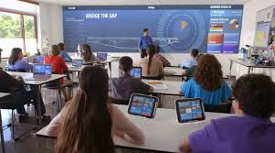
School subjects
In History classes, students look at how their views of history and historical events have been shaped by media. Studying films, newspapers and even their own textbooks helps students see how the nature of each medium shapes how history is told.
In Geography classes, students analyze how news coverage influences on how we view different parts of the world – and the people who live there.

Slide 4
Bulgarian Studies 8th grade
13. Media Spaces as Environments for Interaction
Types of Media
Modern media comes in many different formats, including print media (books, magazines, newspapers), television, movies, video games, music, cell phones, various kinds of software, and the Internet. Each type of media involves both content, and also a device or object through which that content is delivered.
Key Characteristics of Social Media
Creating Social Media messages

Slide 5
Bulgarian Studies 8th grade
14. Media Texts in Virtual Space
Media texts currently reflect all the features of world view of contemporary man: personification͕ intertextuality, mentality, value system and the so-called clip thinking/deconstruction of narratives.
Modern media discourse - is the space of various media texts that differentiate in media-cultural features and the usage of specific codes of perception.

Slide 6
Social Studies 8th grade
Kinds of relationships we see modeled in media products popular with youth, and what messages do youth take from them? How do digital media such as cell phones and the Internet affect our relationships with others, and how can we maintain healthy relationships using these media?

Slide 7
ENGLISH
In practice, elements of Media Education can be easily inserted in the English curriculum.
Developing students’ media literacy through integrating mass media resources into the English classroom is a demanding task for the language teacher who must possess interdisciplinary knowledge and keep developing it alongside with the students. The media-oriented classroom integrated approach can be employed in practical English courses across a wide range of English levels to ensure competent level of students’ media literacy.

Slide 8
ENGLISH
Blogging
Body Image
Cell Phones and Texting
Comics
Crime Portrayal
Digital Health
Diversity in Media
Environment
Events
Media Production
Movies
Music
Online Ethics
Online Hate
Sexual Exploitation
Social Networking
Sports
Stereotyping
Television
Tobacco Marketing
Online shopping
Persons with Disabilities
Privacy
Privilege in the Media
Professional Development
Religion

Slide 9
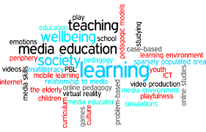
ENGLISH
In the language curricula, students learn media language, critical thinking, and communication skills in the regular pattern of learning with other non-media texts. Basically, media education in language curricula is designed to teach media language, tools of critical media thinking and techniques of media communication.

Slide 10
ENGLISH
Teaching and learning about media language, which includes how media texts are coded and techniques of media communication.
Teaching and learning the differences between the realistic world and the world in media texts. Students learned how to analyze the bias, objectivity, stereotypes and influences in media representation. rent forms of media texts.

